Slide 1


Team 31: Chilly Dog
Bi-Weekly Update 5 Martin Rennaker Grant Franklin Yarentzy Magallanes Sponsor: Rohith Kumar TA: Rohith Kumar
Notes:
Michelle

Slide 2
Project Overview
Problem statement
A car parked outside on a sunny, 95-degree day can reach temperatures of up to 117 degrees Fahrenheit in just 30 minutes.
Approximately 100 dogs die in vehicles from heat exhaustion per year according to the AVMA.
Notes:
***You stop at the store just to run in for a second, and leave your pet in the car with the windows “cracked.” You’re just going to grab a couple of things, so it should all be fine. However, the lines in the store are long, you found a few extra things you needed Your pet should still be okay, though… he’s only been out there for about 20-30 minutes. Right?
Wrong.
***A car parked outside on a sunny, 95-degree Fahrenheit day can reach temperatures of up to 117 degrees Fahrenheit in just 30 minutes.
Your quick trip to the grocery store could be the determining factor between your pets life or death.
**approximatley 100 dogs die from heat exhaustion a year according to the American Veterinary Medical Association.

Slide 3
Solution
Provide ideal cabin conditions to allow your pet to safely stay unattended in a vehicle.
Features:
Does not rely on the battery or motor of your vehicle
Receive real time ambient and cabin temperature readings
Set a desired cabin temperature through the Chilly dog phone application
Receive alerts for low battery and extreme temperature conditions
Notes:
***We, the chilly dogs, have created a device to keep your cabin cool while you are away and assure the safety of your pet.
***The chilly dog is a battery powered car A/C system. that can cool the inside of your vehicle without relying on the motor of your car or its battery.
***Chilly Dog users will be able to receive real time temperature reading of the ambient and cabin temperature, adjust the desired output temperature using the chilly dog phone application, and even receive alerts when the device has low battery or conditions in the cabin become unfit for the pet.

Slide 4
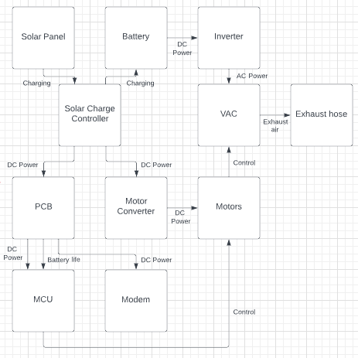
Integrated System Diagram
UART
Notes:
Eric

Slide 5
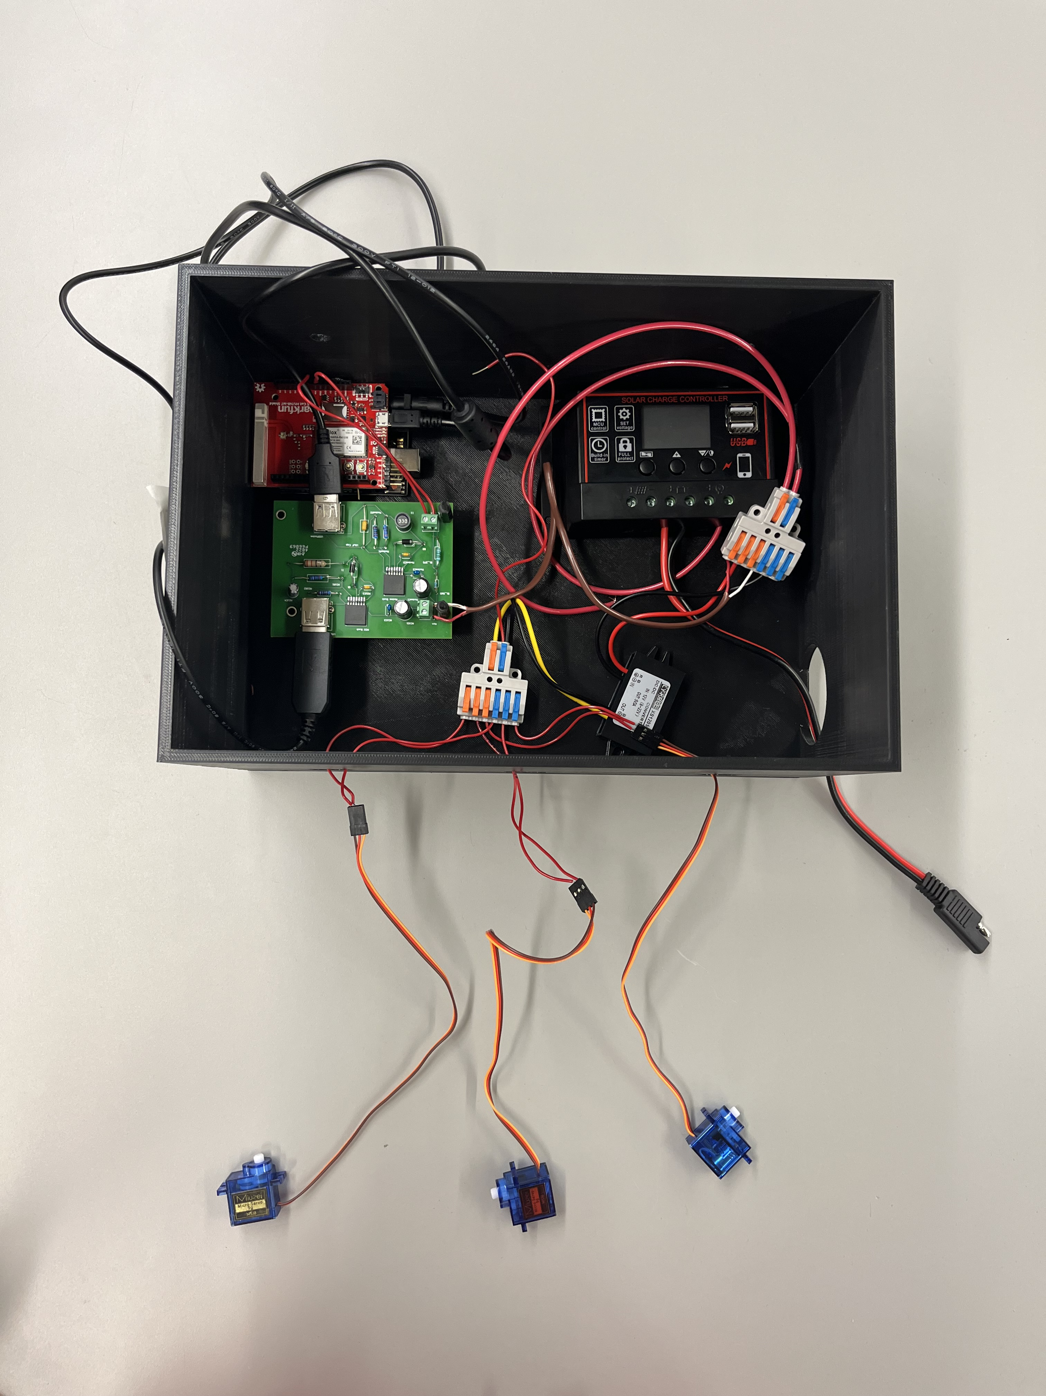
Integrated System Design
Modem and MCU
Solar Charge Controller
PCB
DC to DC Converter
Battery Lead
Motors

Slide 6
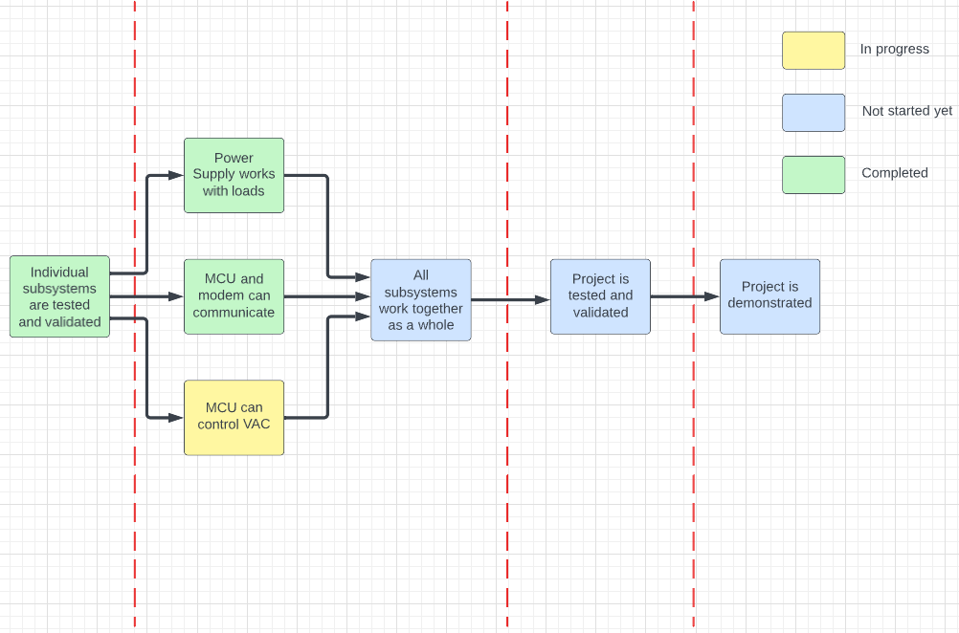
Project Timeline
8/28-9/23
9/24-10/28
10/29-11/30
12/1-12/2

Slide 7
Grant Franklin
Accomplishments since last update 16 hrs of effort | Ongoing progress/problems and plans until the next presentation
Validated buck regulator circuit integration with real loads and power supply input Retested battery life voltage divider on final PCB Finished creating all connections for power supply to fully integrate with other subsystems Conducted line/load tests for buck regulator circuits on final PCB Validated correct 12V battery output with electronic load Validated battery life voltage divider to MCU sends and receives the correct voltage for various power supply voltages Validated battery life voltage divider to MCU sends and receives correct voltage of 12V battery input Validated that buck regulator circuits have correct outputs with 12V battery input Validated that all circuits work simultaneously while connected to 12V battery | Continue testing loads while powered by 12V battery Begin testing scenarios of system Help redesign final design of enclosure

Slide 8
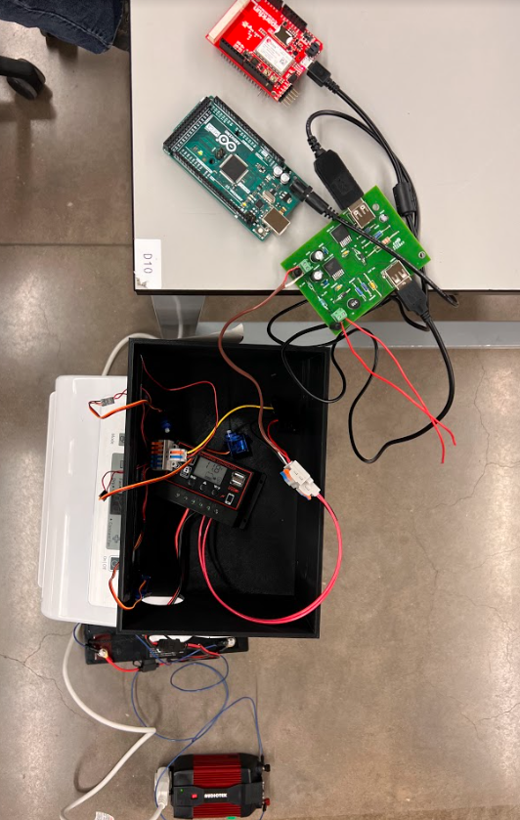
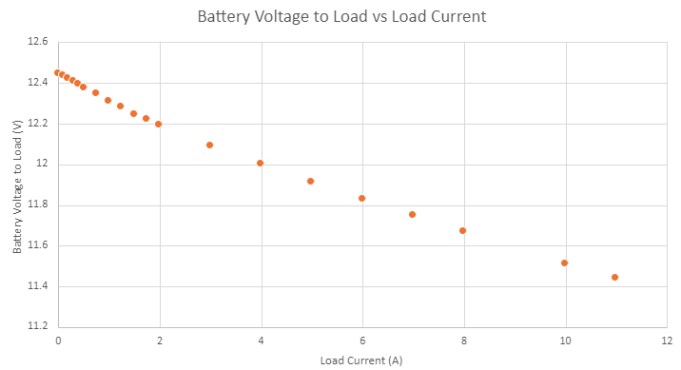
Grant Franklin
Max Current Draw: 9.55A
Nominal Current Draw: 8.4A
Battery voltage will be stepped down by ~0.8V at full operation
Full system being powered simultaneously by 12V battery

Slide 9
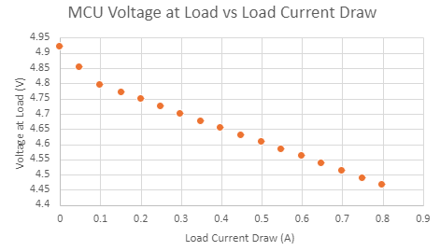
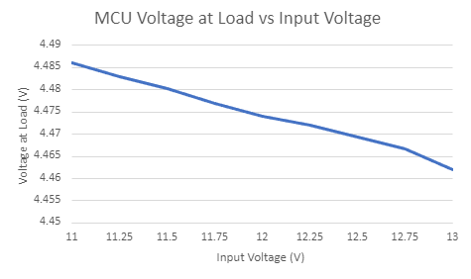
Grant Franklin
At max current, voltage is still at an acceptable value for USB output
It is also stepped up within the cable to 9V for the Arduino for extra regulation
At max current, voltage decreases a very small amount with varying input voltages

Slide 10
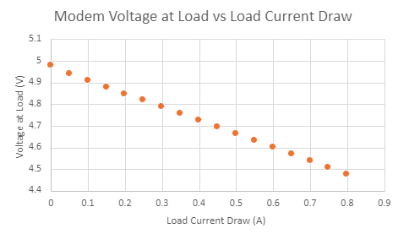
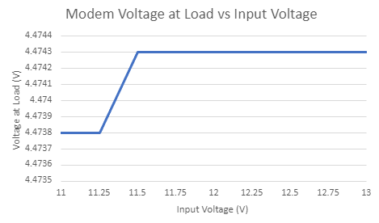
Grant Franklin
At max current, voltage is still at an acceptable value for USB output
At max current, voltage decreases a very small amount with varying input voltages

Slide 11
Yarentzy Magallanes
Accomplishments since last update 13 hrs of effort | Ongoing progress/problems and plans until the next presentation
Created and assembled motor enclosure Validated correct system operation for user input Calculated and validated optimal range for ADC battery percentage output Validated PCB and battery integration to power MCU | Include slot for temperature sensor in motor enclosure Collaborate with Martin to validate commands sent from MCU to modem
Notes:
Howdy my name is yarentzy and I am in charge of the MCU. Since the last presentation I have created the encloser for the motors to control the VAC system, Validated user input possibilities, and have validated the MCUs ability to read the battery percentage and have made tremendous progress in the integration of the power supply by validating the PCB and the Battery in powering the chilly dog as grant mentioned before.
In the next two weeks will be working on modifying the motor enclosure to include a slot for the temperature sensor, and working with martin in assuring the messages exchanged between the modem and MCU

Slide 12
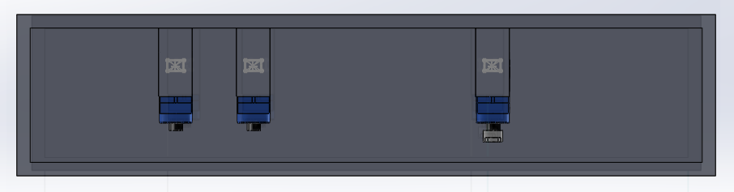
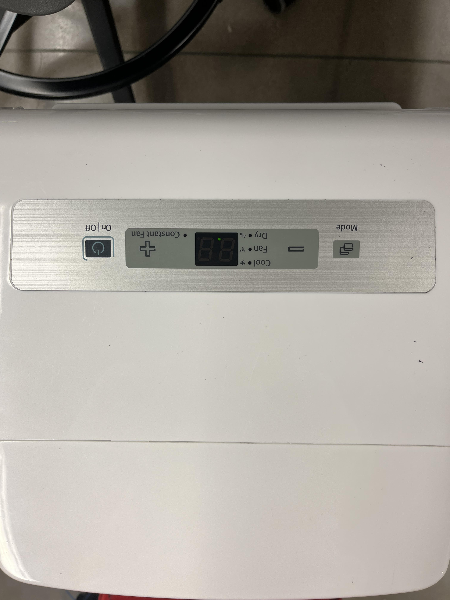
Motor Enclosure
Under View:
Motor arms align with buttons to turn the VAC On/Off, set temperature higher (+) and lower (-)
Notes:
Here we see an image of the motor enclosure. We are looking at it from the bottom to highlight the positioning of the motors. They are aligned to the buttons on top of the AC unit and control the on/off status, and can adjust the temp to be higher or lower according to user input.

Slide 13
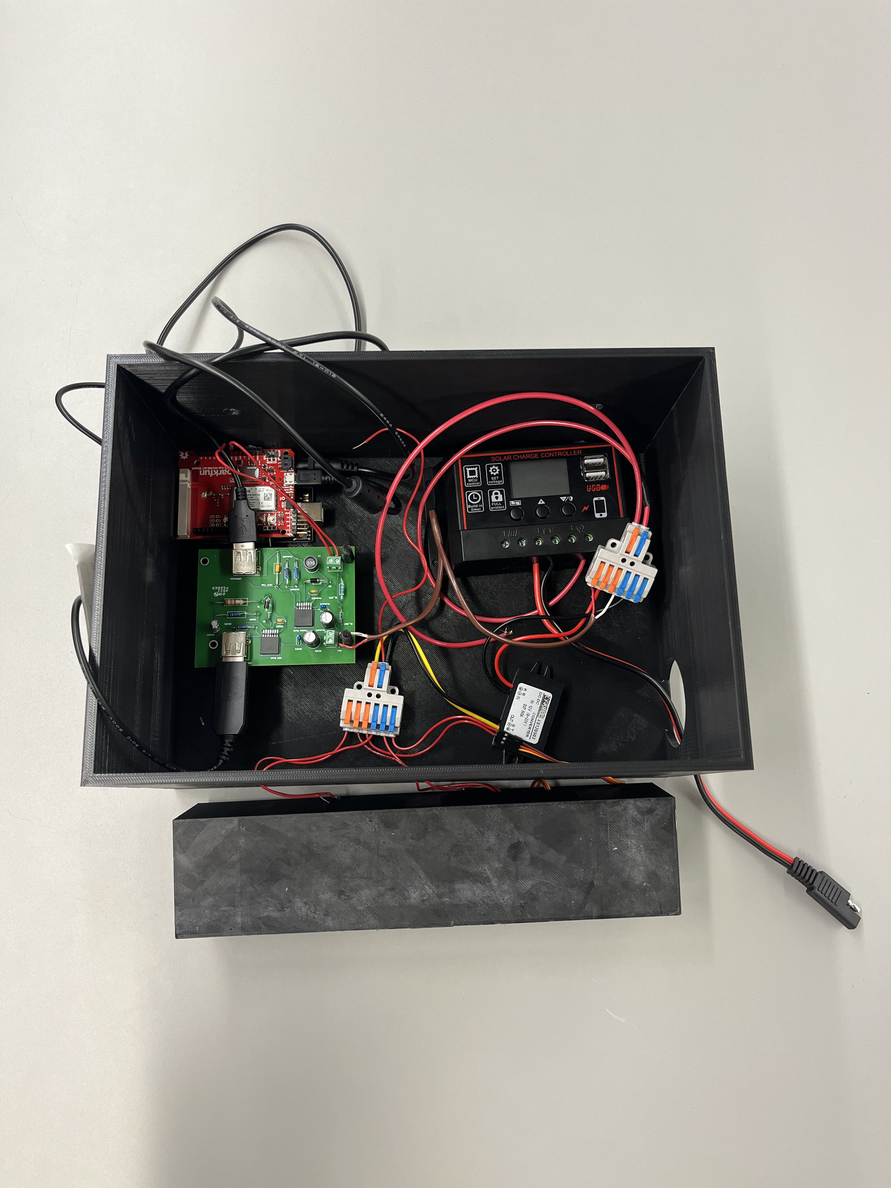
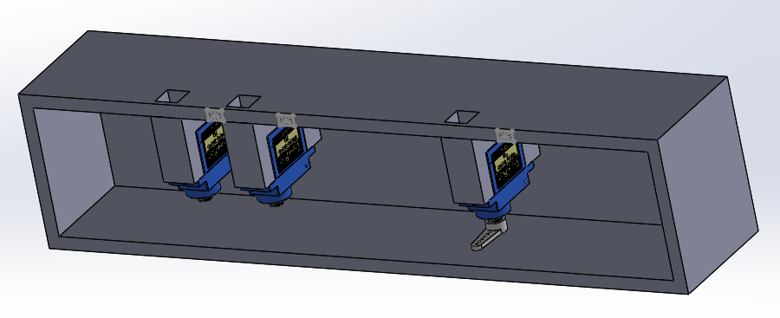
Motor Enclosure
Motor cables that lead to main enclosure
Notes:
Here is another view and a visual of is placement in regard to our main enclosure

Slide 14
Yarentzy Magallanes
ADC Battery Percentage
Power Supply | Battery % | ADC Stepped-Down Input Voltage (V) | Arduino Digital | Arduino (V) | Voltage Difference (V)
13 | 100 | 4.211 | 853 | 4.1626 | 0.0484
12.55 | 75 | 4.064 | 823 | 4.016 | 0.048
12.1 | 50 | 3.919 | 794 | 3.874 | 0.045
11.65 | 25 | 3.773 | 764 | 3.728 | 0.045
11.38 | 10 | 3.686 | 746 | 3.6404 | 0.0456
11.29 | 5 | 3.657 | 740 | 3.6112 | 0.0458
Actual Battery
12.4 |  | 4.0226 | 815 | 3.9772 | 0.0454
Notes:
This is a graph of the ADC data we gathered. Studies were conducted using the power supply in lab and the actual battery. I will now run you through this graph. When the battery is outputting 13 volts the battery is at 100% grants voltage divider steps that 13 v down to 4.21. this 4.21 is what is being read by my arduino. When read the arduino outputs a digital value of 853. The Arduino has a 10 bit ADC converter using this we are able to calculate the voltage that the arduino is actualy detecting and it comes out to be 48mv less than the actual. As of right now the arduino tells the user the battery is at 100% if it detects anything above 4.016 and below 4.2.

Slide 15
Martin Rennaker
Accomplishments since last update 15 hrs of effort | Ongoing progress/problems and plans until the next presentation
Received new modem Tested new modem with sparkfun given code Changed send text function to work more consistently and retested Verified arduino to app text send, receive, and update app Designed, ordered, and received enclosure | Finish receive text function Implement functions into MCU code Validate MCU-Modem-App System Update and order new enclosure design

Slide 16
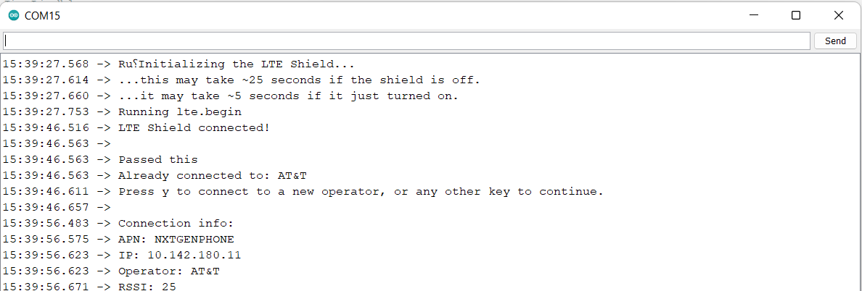
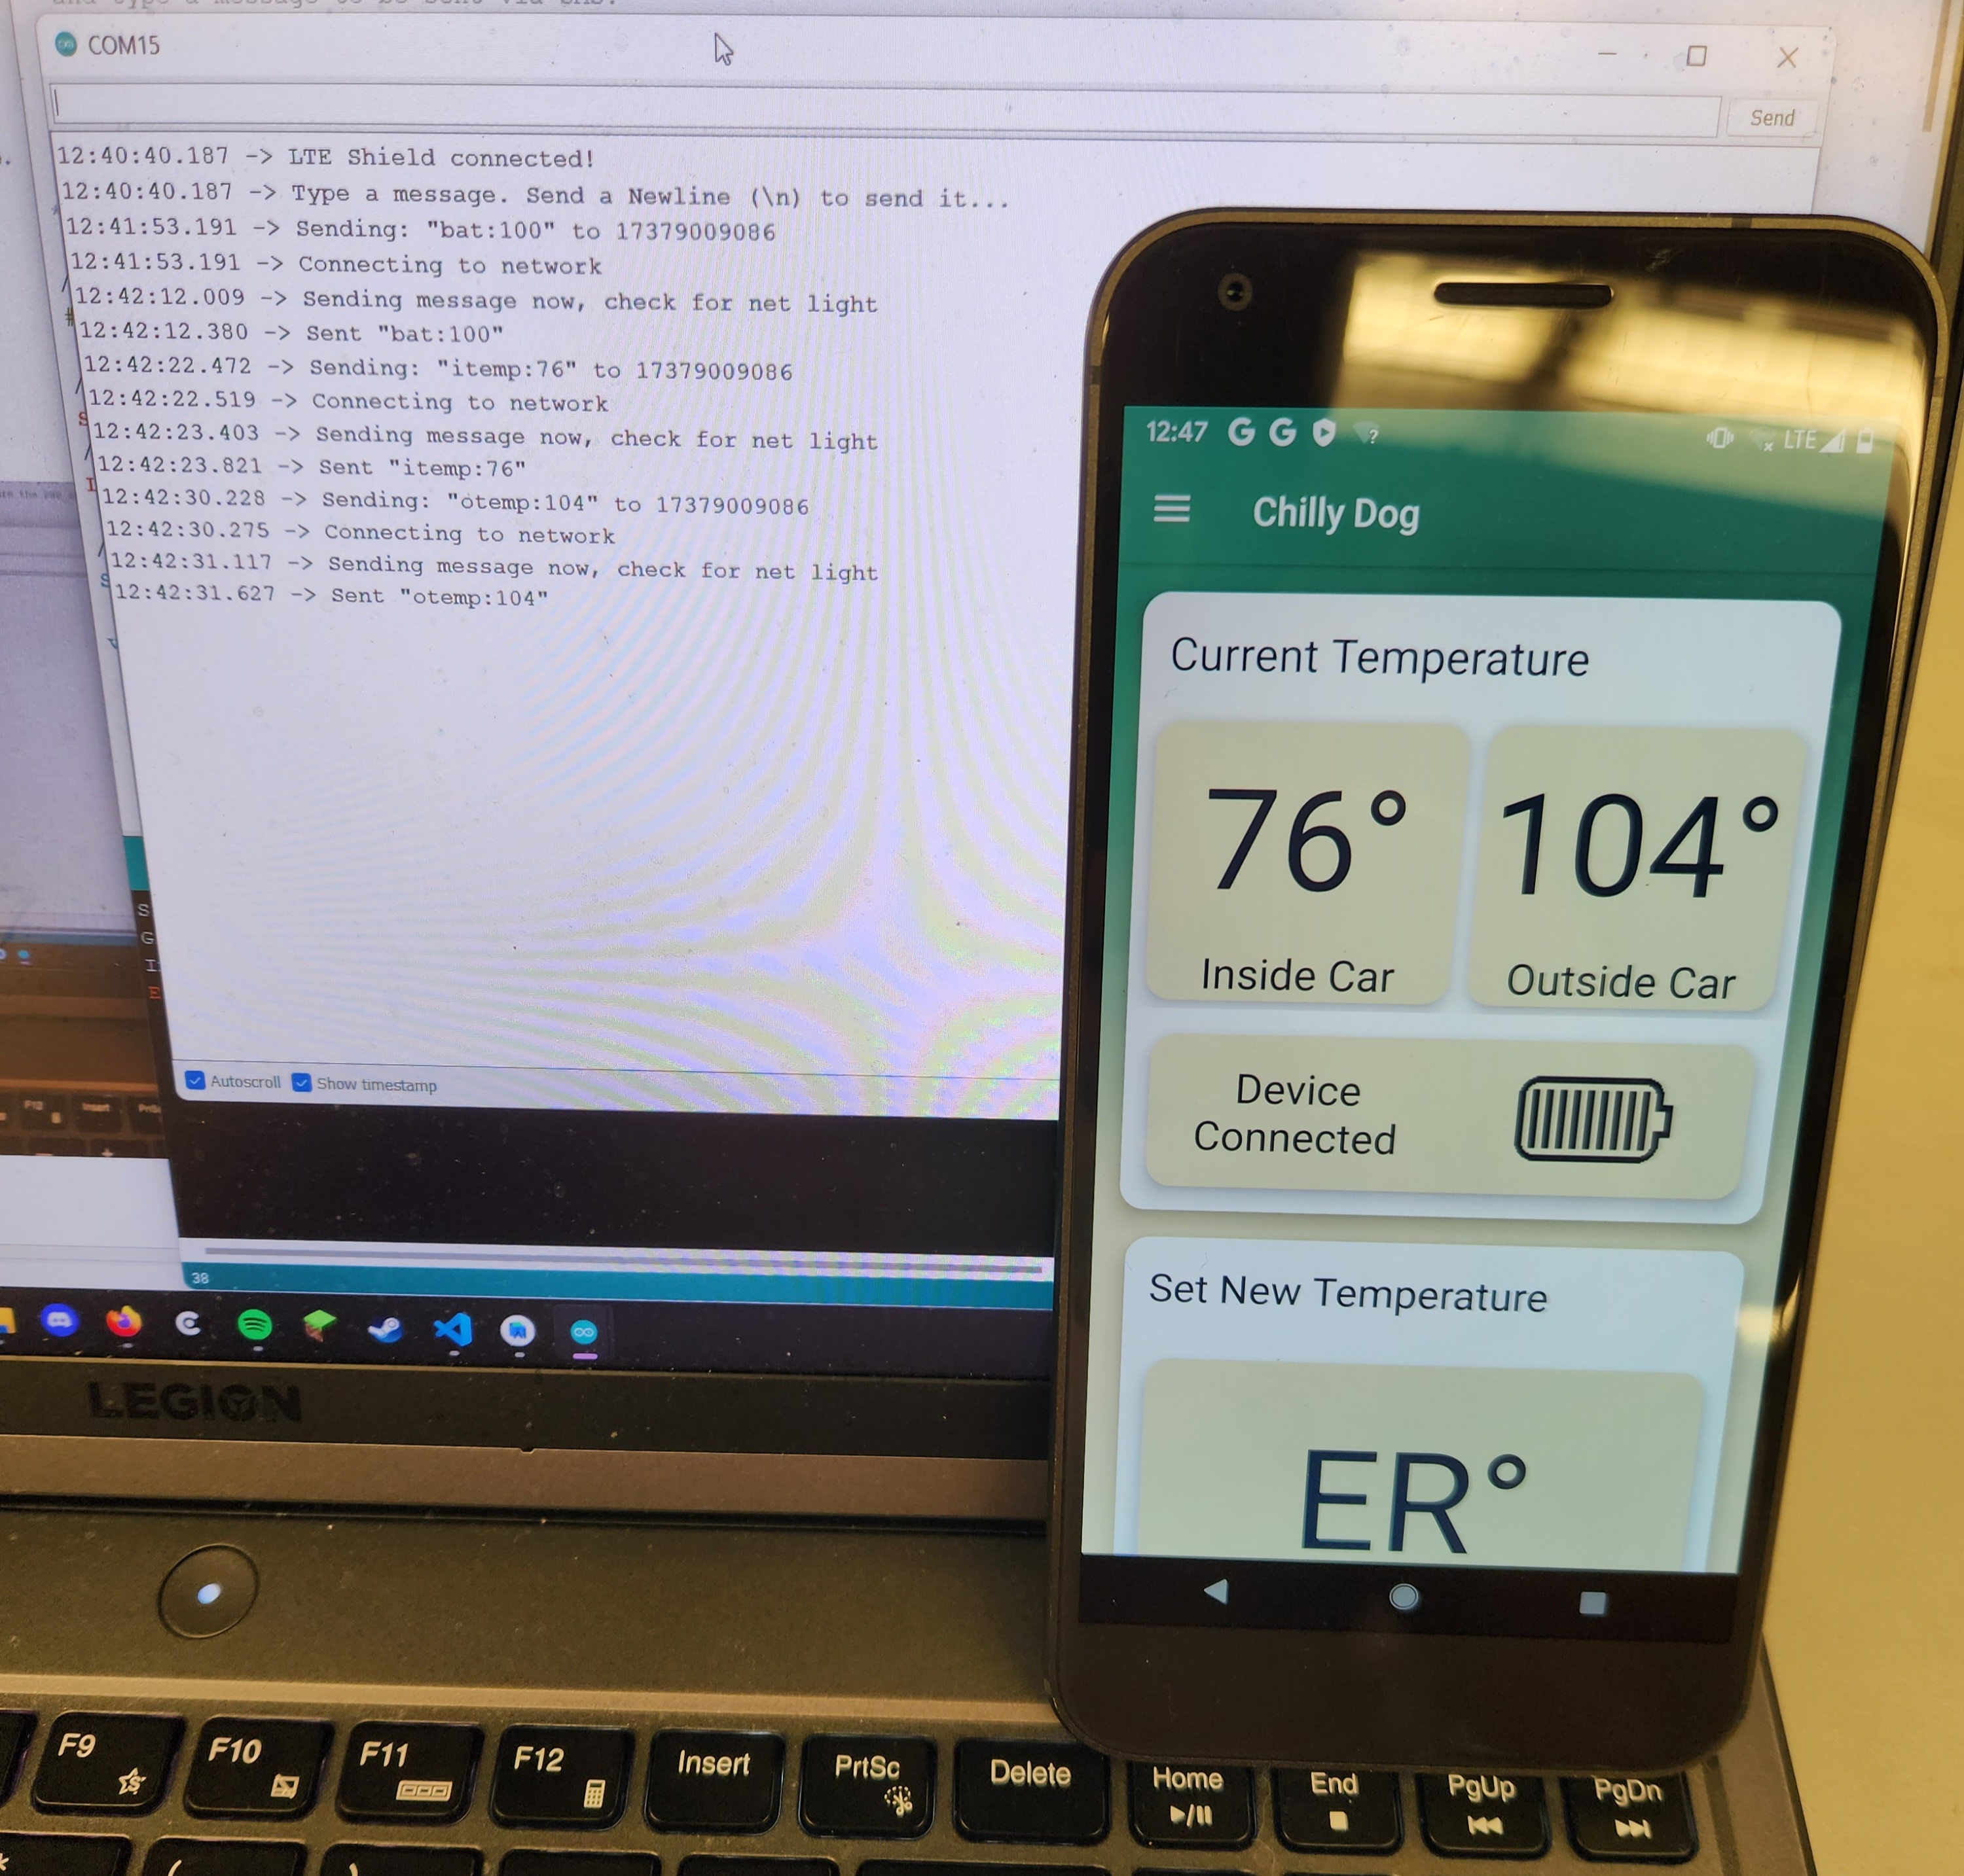
Modem Connection
the modem registering as an operator with AT&T via the Arduino
Modem connecting to app and updating app on current in car status
12:40:40.187 -> LTE Shield connected!
12:40:40.187 -> Type a message. Send a Newline (\n) to send it...
12:41:53.191 -> Sending: "bat:100" to 17379009086
12:41:53.191 -> Connecting to network
12:42:12.009 -> Sending message now, check for net light
12:42:12.380 -> Sent "bat:100"
12:42:22.472 -> Sending: "itemp:76" to 17379009086
12:42:22.519 -> Connecting to network
12:42:23.403 -> Sending message now, check for net light
12:42:23.821 -> Sent "itemp:76"
12:42:30.228 -> Sending: "otemp:104" to 17379009086
12:42:30.275 -> Connecting to network
12:42:31.117 -> Sending message now, check for net light
12:42:31.627 -> Sent "otemp:104"

Slide 17
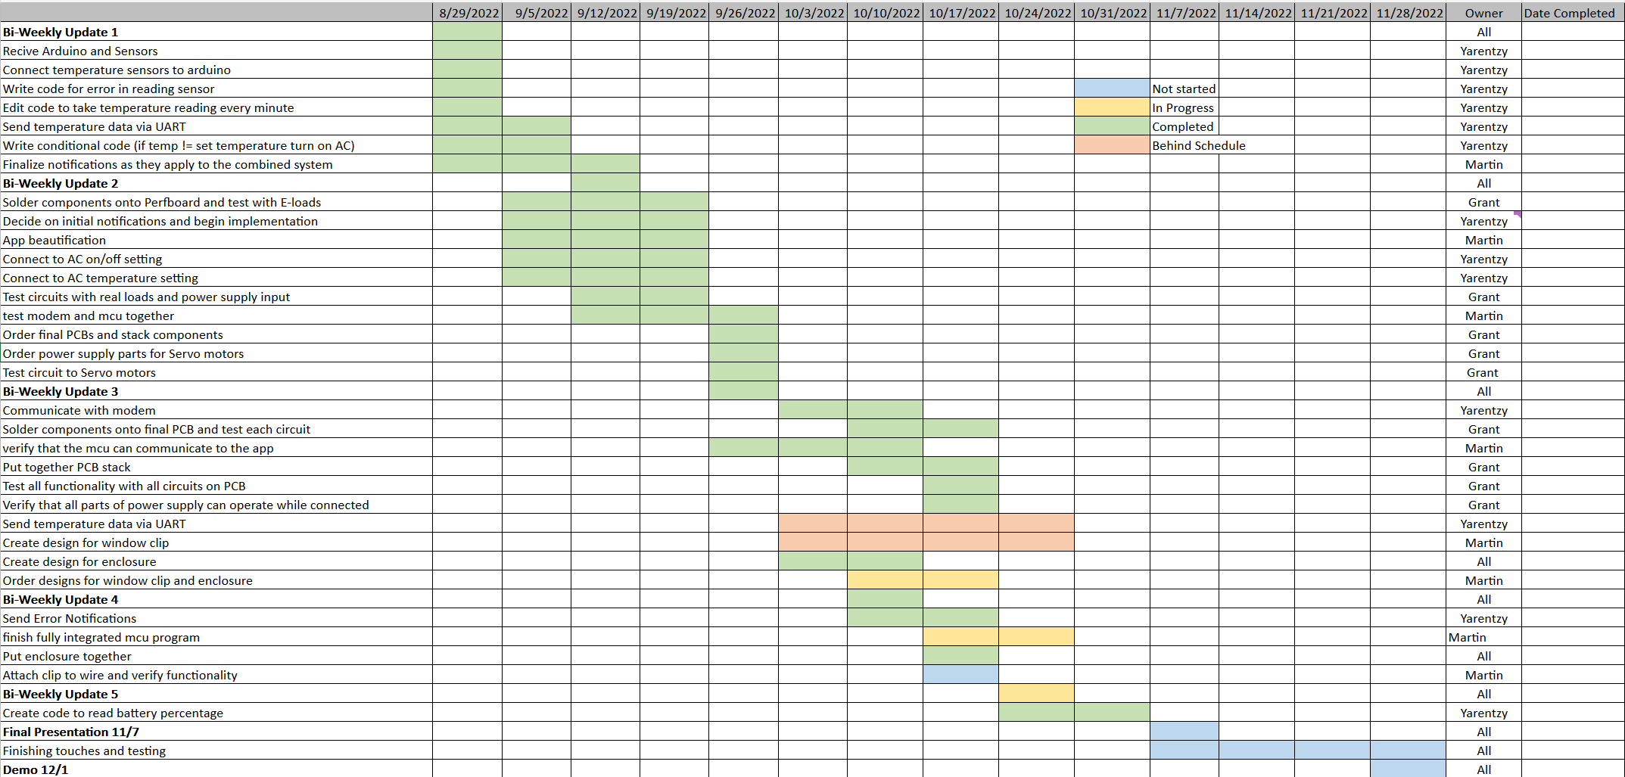
Execution Plan
Notes:
Michelle

Slide 18
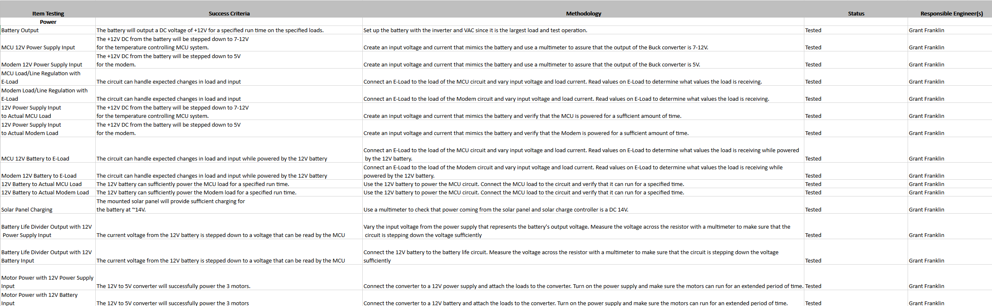
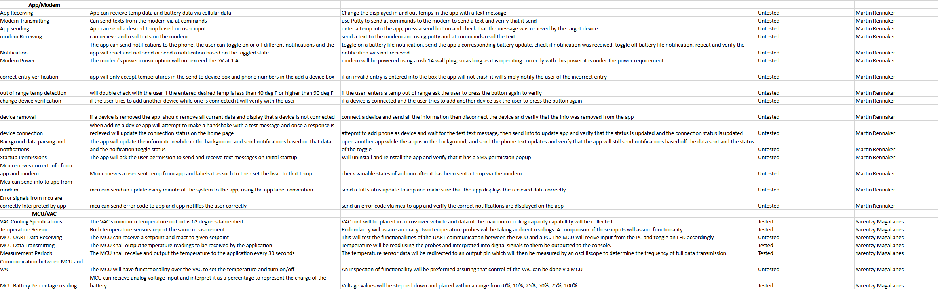
Validation Plan
Notes:
Michelle

Slide 19
Thank you!
Any questions?

